Slide 1

Robot HAT

Slide 2
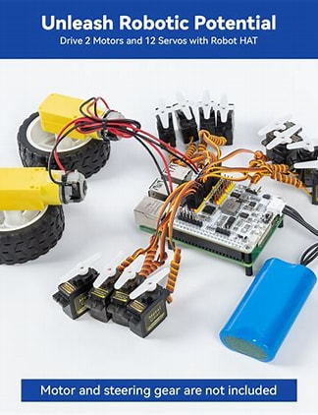
What is Robot HAT?
It’s A Robot HAT (Hardware Attached on Top) is an expansion board designed to control motors, servos, and sensors through the Raspberry Pi’s GPIO(General Purpose Input/Output) pins.
The purpose is to simplify robotics development by providing dedicated motor drivers, servo control, and power management.
It works with with Raspberry Pi 5, 4, and 3 via the 40-pin GPIO header.
Typical Used for small autonomous robots, robotic arms, or smart-vehicle projects

Slide 3
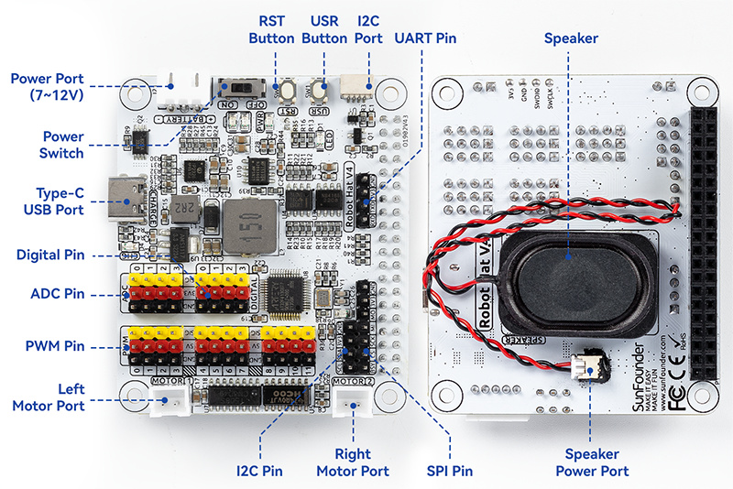
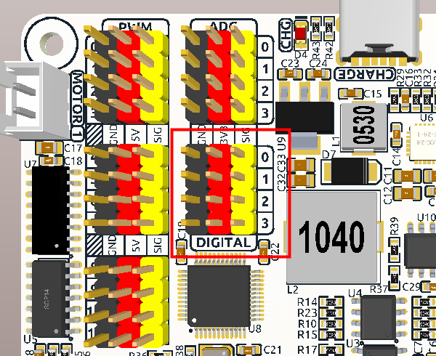
Hardware Features of the Robot HAT
Motor Drivers: Dual DC(Direct Current) motor ports and stepper-motor control via PWM.
Servo Ports: Typically 4–8 PWM channels for hobby servos.
Sensor Interfaces: I²C, SPI, and UART ports for distance, line, or motion sensors.
Power System: Built-in battery management and 5 V regulator for the Pi.
Other Features: Onboard buzzer, infrared receiver, and programmable LED indicators.

Slide 4
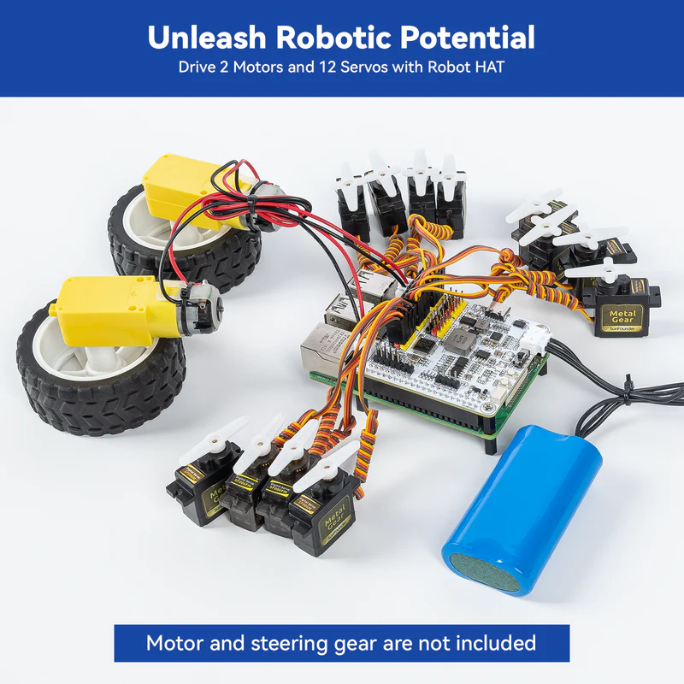
How the Robot HAT Works with Raspberry Pi 5
Connects directly to the Pi’s 40-pin GPIO header — no additional wiring needed.
The Pi 5 runs control scripts (Python 3 or C++) that send PWM and I²C commands through GPIO.
The Robot HAT’s microcontroller or driver IC translates these signals into motor/servo movements.
Libraries like picar-x, adafruit-motorHAT, or gpiozero simplify programming.
Real-time control is handled by the Pi CPU; low-level power regulation and safety handled by the HAT.

Slide 5

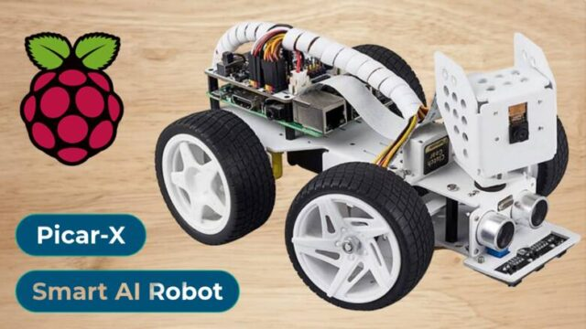
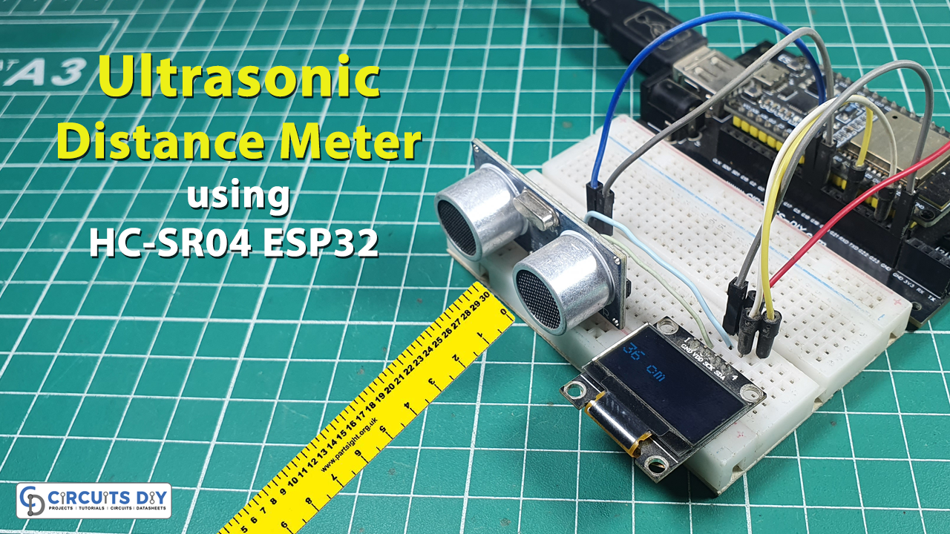
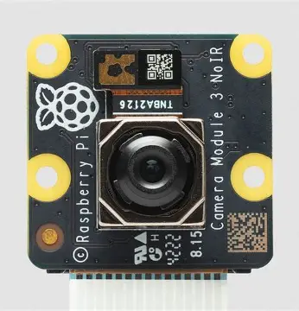
Programming & Applications
Software Support: Python libraries such as picar-x, RPi.GPIO, gpiozero, and PCA9685.
Typical Projects:
Line-following robot
Obstacle-avoidance car
Robotic arm controller
Smart sensor platform
Integration Example:
Ultrasonic sensor via I²C(Inter-Integrated Circuit) for distance measurement
Servo motor for steering control
Pi Camera for computer vi

Slide 6
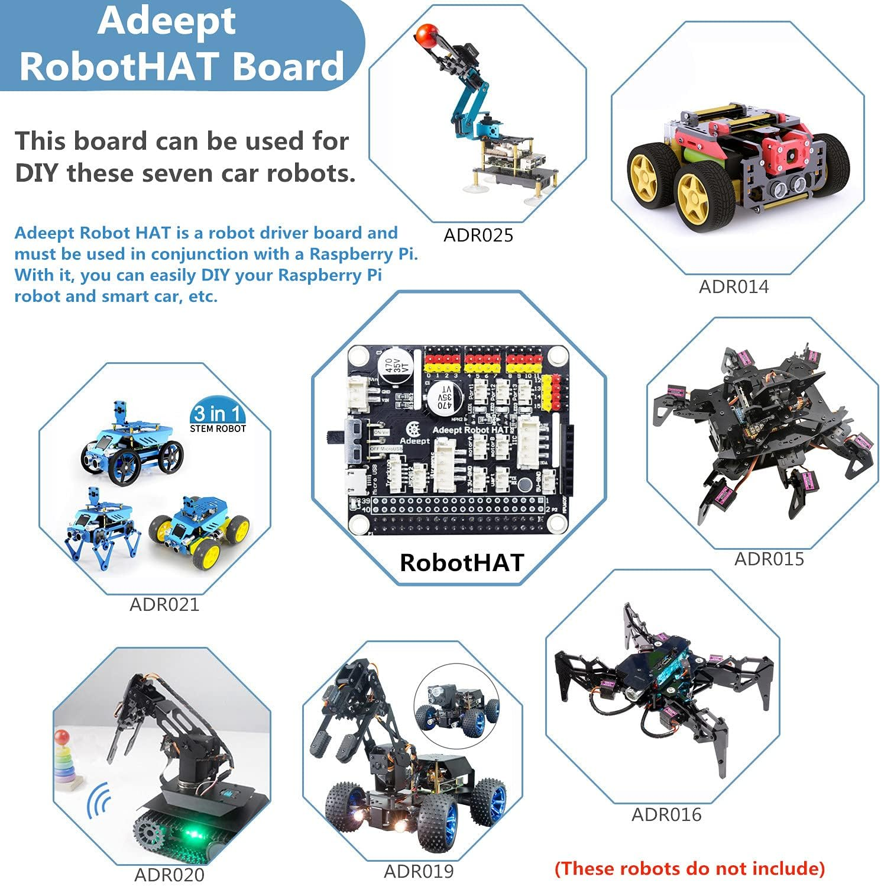
Advantages of Using Robot HAT with Pi 5
Eliminates the need for a separate microcontroller (Arduino or ESP32[Espressif Systems 32-bit microcontroller]).
Provides stable power to motors and the Pi from a single battery source.
Compact and stackable design for robot chassis.
Supports multiple sensor types — great for STEM(Science, Technology, Engineering, and Mathematics) and AI learning.
Fully compatible with Raspberry Pi OS and Python.

Slide 7
References
“Robot Hat v4.” Sunfounder, www.sunfounder.com/projects/robot-hat-v4/en/latest/robot_hat_v4.html. Accessed 13 Oct. 2025.
Raspberry Pi Documentation – https://www.raspberrypi.com/documentation/
Waveshare Robot HAT Product Page – https://www.waveshare.com/wiki/Robot_HAT
SunFounder PiCar X Kit – https://www.sunfounder.com/

